Slide 1
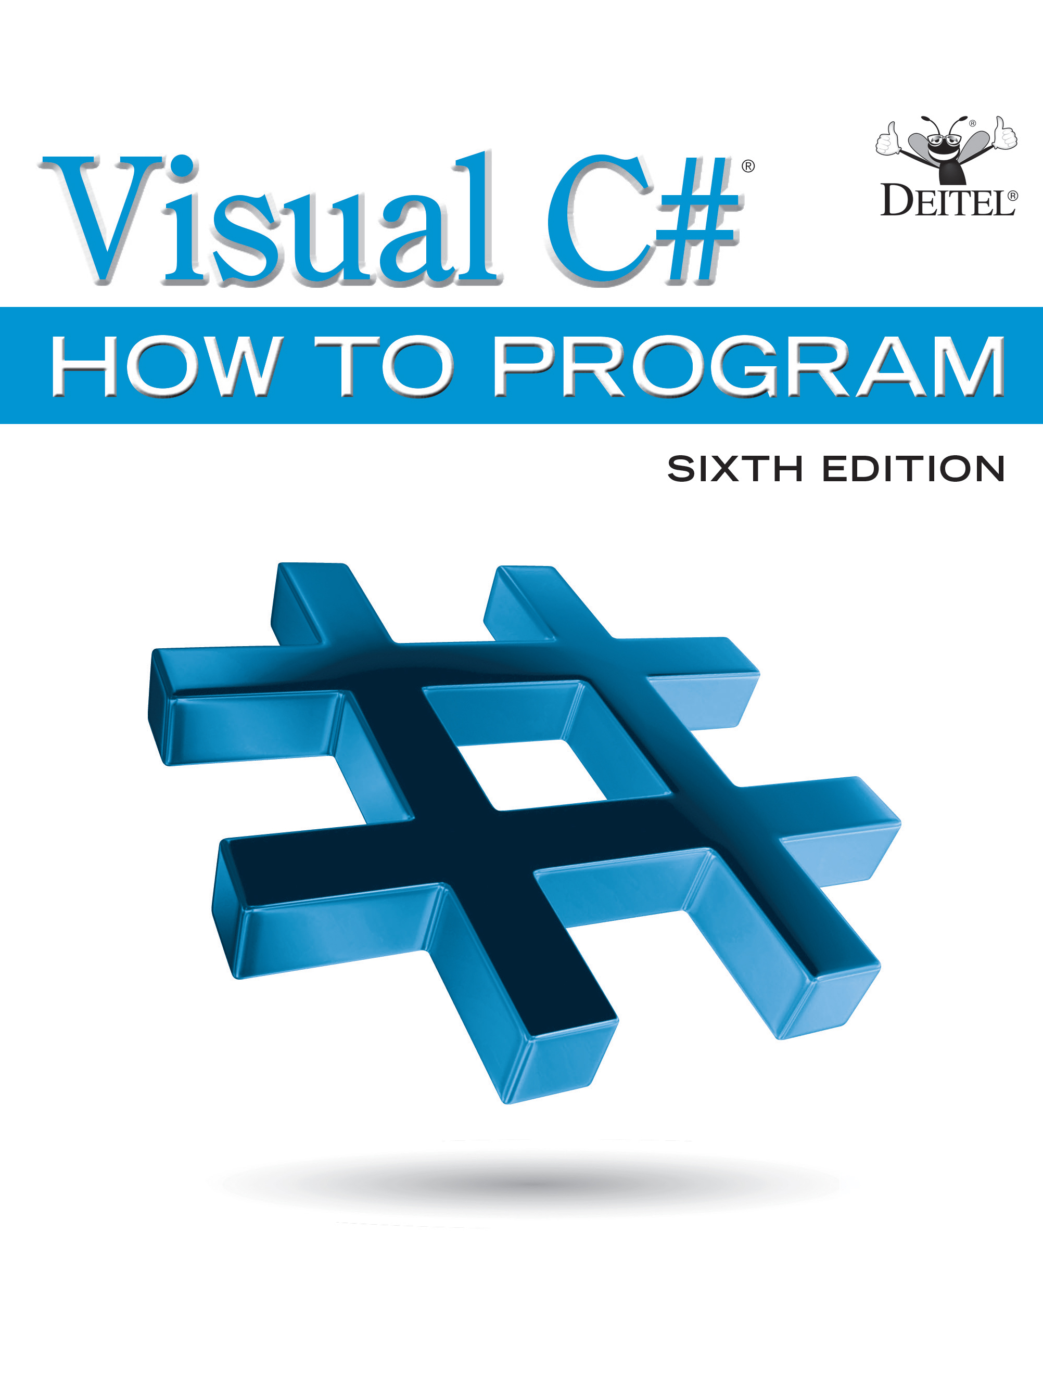
Visual C sharp® How to Program
Sixth Edition
Chapter 3
Introduction to C sharp App Programming
Copyright © 2017 Pearson Education, Inc. All Rights Reserved
Notes:
If this PowerPoint presentation contains mathematical equations, you may need to check that your computer has the following installed:
1) MathType Plugin
2) Math Player (free versions available)
3) NVDA Reader (free versions available)

Slide 2
Learning Objectives
Write simple
apps using code rather than visual programming.
Input data from the keyboard and output data to the screen.
Use
6’s string interpolation to create formatted strings by
inserting values into string literals.
Declare and use data of various types.
Store data in memory and retrieve it.
Use arithmetic operators.
Determine the order in which operators are applied.
Write decision-making statements with equality and relational operators.

Slide 3
Outline (1 of 4)
3.1 Introduction
3.2 Simple App: Displaying a Line of Text
3.2.1 Comments
3.2.2 using Directive
3.2.3 Blank Lines and Whitespace
3.2.4 Class Declaration
3.2.5 Main Method
3.2.6 Displaying a Line of Text
3.2.7 Matching Left ({) and Right (}) Braces

Slide 4
Outline (2 of 4)
3.3 Creating a Simple App in Visual Studio
3.3.1 Creating the Console App
3.3.2 Changing the Name of the App File
3.3.3 Writing Code and Using IntelliSense
3.3.4 Compiling and Running the App
3.3.5 Syntax Errors, Error Messages and the Error List Window
3.4 Modifying Your Simple
App
3.4.1 Displaying a Single Line of Text with Multiple Statements
3.4.2 Displaying Multiple Lines of Text with a Single Statement

Slide 5
Outline (3 of 4)
3.5 String Interpolation
3.6 Another
App: Adding Integers
3.6.1 Declaring the int Variable number1
3.6.2 Declaring Variables number2 and sum
3.6.3 Prompting the User for Input
3.6.4 Reading a Value into Variable number1
3.6.5 Prompting the User for Input and Reading a Value into number2
3.6.6 Summing number1 and number2
3.6.7 Displaying the sum with string Interpolation
3.6.8 Performing Calculations in Output Statements

Slide 6
Outline (4 of 4)
3.7 Memory Concepts
3.8 Arithmetic
3.8.1 Arithmetic Expressions in StraightLine Form
3.8.2 Parentheses for Grouping Subexpressions
3.8.3 Rules of Operator Precedence
3.8.4 Sample Algebraic and
Expressions
3.8.5 Redundant Parentheses
3.9 Decision Making: Equality and Relational Operators
3.10 Wrap-Up

Slide 7
3.1 Introduction
Console apps input and output text in a console window, which in Windows is known as the Command Prompt.
Figure 3.1 shows the app’s source code and output.

Slide 8
3.2 Simple App: Displaying a Line of Text
Figure 3.1 shows the app’s source code and output.

Slide 9
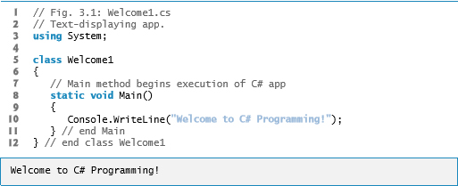
Figure 3.1 Text-Displaying App

Slide 10

3.2.1 Comments (1 of 2)
You’ll insert comments to document your apps and improve their readability.
The
compiler ignores comments, so they do not cause
the computer to perform any action when the app executes.
is called a single-line comment, because it terminates at the end of the line on which it appears.
A comment that begins with

Slide 11
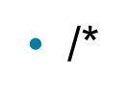

3.2.1 Comments (2 of 2)
comment also can begin in the middle of a line and continue until the end of that line.
A
Delimited comments begin with the delimiter
and end with the delimiter
. All text between the delimiters is ignored by the compiler.

Slide 12
Common Programming Error 3.1
Forgetting one of the delimiters of a delimited comment is a syntax error. A programming language’s syntax specifies the grammatical rules for writing code in that language. A syntax error occurs when the compiler encounters code that violates
language rules. In this case, the compiler does not
produce an executable file. Instead, it issues one or more error messages to help you identify and fix the incorrect code. Syntax errors are also called compiler errors, compile-time errors or compilation errors, because the compiler detects them during the compilation phase. You cannot execute your app until you correct all the compilation errors in it. We’ll see that some compile-time errors are not syntax errors.

Slide 13
Error-Prevention Tip 3.1
When the compiler reports an error, the error may not be in the line indicated by the error message. First, check the line for which the error was reported. If that line does not contain syntax errors, check several preceding lines.

Slide 14
3.2.2 Using Directive
A using directive tells the compiler where to look for a predefined class that’s used in an app.
Predefined classes are organized under namespaces—named collections of related classes. Collectively, .NET’s predefined namespaces are known as the .NET Framework Class Library.
The System namespace contains the predefined Console class and many other useful classes.

Slide 15
Error-Prevention Tip 3.2
Forgetting to include a using directive for a namespace that contains a class used in your app typically results in a compilation error, containing a message such as “The name 'Console' does not exist in the current context.” When this occurs, check that you provided the proper using directives and that the names in them are spelled correctly, including proper use of uppercase and lowercase letters. In the editor, when you hover over an error’s red squiggly line, Visual Studio displays a box containing the link "show potential fixes." If a using directive is missing, one potential fix shown is to add the using directive to your code—simply click that fix to have Visual Studio edit your code.

Slide 16
3.2.3 Blank Lines and Whitespace
Blank lines and space characters make code easier to read and together with tab characters are known as whitespace.
Whitespace is ignored by the compiler.

Slide 17
3.2.4 Class Declaration (1 of 3)
Keywords (sometimes called reserved words) are
reserved for use by
and are always spelled with
all lowercase letters.
Every app consists of at least one class declaration that is defined by the programmer. These are known as user-defined classes.
The class keyword introduces a class declaration and is immediately followed by the class name.

Slide 18
3.2.4 Class Declaration (2 of 3)
A class name is an identifier:
Series of characters consisting of letters, digits and underscores.
Cannot begin with a digit and does not contain spaces.
The complete list of
keywords is shown in Figure 3.2.
The contextual keywords in Figure 3.2 can be used as identifiers outside the contexts in which they are keywords, but for clarity this is not recommended.

Slide 19
Good Programming Practice 3.1
By convention, always begin a class name’s identifier with a capital letter and start each subsequent word in the identifier with a capital letter.

Slide 20
Common Programming Error 3.2
is case sensitive. Not using the proper uppercase and
lowercase letters for an identifier normally causes a compilation error.

Slide 21
Common Programming Error 3.3
Using a keyword as an identifier is a compilation error.

Slide 22
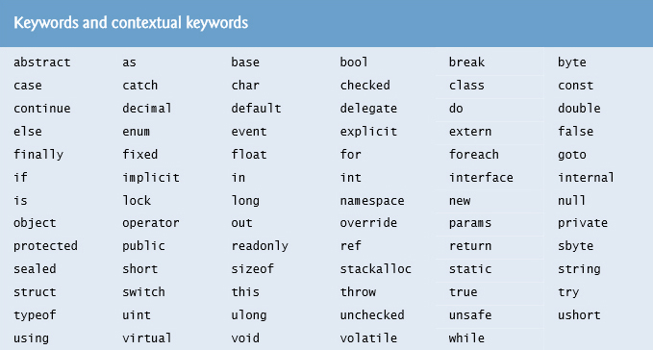
Figure 3.2 Keywords and Contextual Keywords (1 of 2)

Slide 23
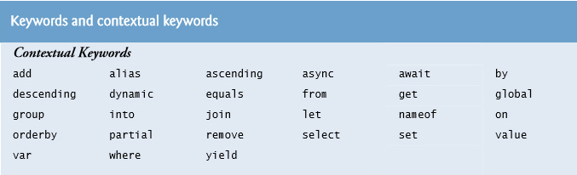
Figure 3.2 Keywords and Contextual Keywords (2 of 2)

Slide 24
3.2.4 Class Declaration (3 of 3)
is case sensitive—that is, uppercase and lowercase
letters are distinct, so a1 and A1 are different (but both valid) identifiers.

Slide 25
Good Programming Practice 3.2
By convention, a file that contains a single class should have a name that’s identical to the class name (plus the .c s extension) in both spelling and capitalization. This makes it easy to identify which file contains the class’s declaration.

Slide 26
3.2.4 Class Declaration
A left brace, {, begins the body of every class declaration.
A corresponding right brace, }, must end each class declaration.

Slide 27
Good Programming Practice 3.3
Indent the entire body of each class declaration one “level” of indentation between the left and right braces that delimit the body of the class. This format emphasizes the class declaration’s structure and makes it easier to read. You can let the I D E format your code by selecting Edit → Advanced → Format Document.

Slide 28
Good Programming Practice 3.4
Set a convention for the indent size you prefer, then uniformly apply that convention. The Tab key may be used to create indents, but tab stops vary among text editors. Microsoft recommends four-space indents, which is the default in Visual Studio. Due to the limited width of code lines in print books, we use three-space indents—this reduces the number of code lines that wrap to a new line, making the code a bit easier to read. We show how to set the tab size in the Before You Begin section that follows the Preface.

Slide 29
Error-Prevention Tip 3.3
Whenever you type an opening left brace, {, in your app, the I D E immediately inserts the closing right brace, }, then repositions the cursor between the braces so you can begin typing the body. This practice helps prevent errors due to missing braces.

Slide 30
Common Programming Error 3.4
It’s a syntax error if braces do not occur in matching pairs.

Slide 31
3.2.5 Main Method
Parentheses after an identifier indicate that it is an app building block called a method. Class declarations normally contain one or more methods.
Method names usually follow the same casing capitalization conventions used for class names.
For each app, one of the methods in a class must be called Main; otherwise, the app will not execute.
A method performs a task and returns information it completes its task.
Keyword void indicates that Main will not return any information.
The body of a method declaration begins with a left brace and ends with a corresponding right brace.

Slide 32
Good Programming Practice 3.5
Indent each method declaration’s body statements one level of indentation between the left and right braces that define the body.

Slide 33
3.2.6 Displaying a Line of Text (1 of 2)
Characters between double quotation marks are strings.
Whitespace characters in strings are not ignored by the compiler.
The Console.WriteLine method displays a line of text in the console window.
The string in parentheses is the argument to the Console.WriteLine method.
Method Console.WriteLine performs its task by displaying (also called outputting) its argument in the console window.

Slide 34
3.2.6 Displaying a Line of Text (2 of 2)
A method is typically composed of one or more statements that perform the method’s task.
Most statements end with a semicolon.

Slide 35
3.3.1 Creating the Console App
Select File → New → Project… to display the New Project dialog (Figure 3.3).
At the left side of the dialog, under Installed → Templates →
select the Windows category, then in the middle
of the dialog select the Console Application template.
In the dialog’s Name field, type Welcome1, then click OK to create the project.

Slide 36
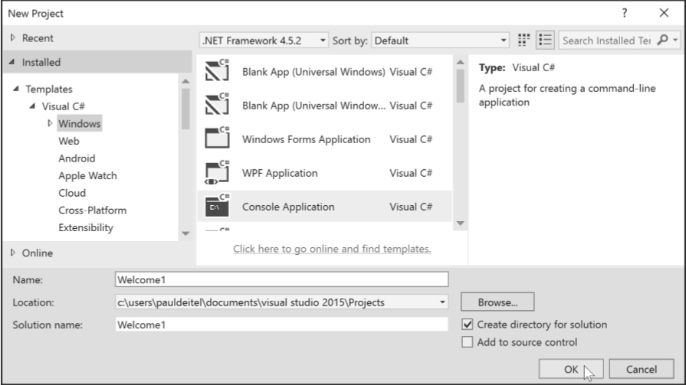
Figure 3.3 Selecting Console Application in the New Project Dialog

Slide 37
3.3 Creating a Simple App in Visual Studio
The I D E now contains the open console app.
The code coloring scheme used by the I D E is called syntax-color highlighting and helps you visually differentiate code elements.

Slide 38
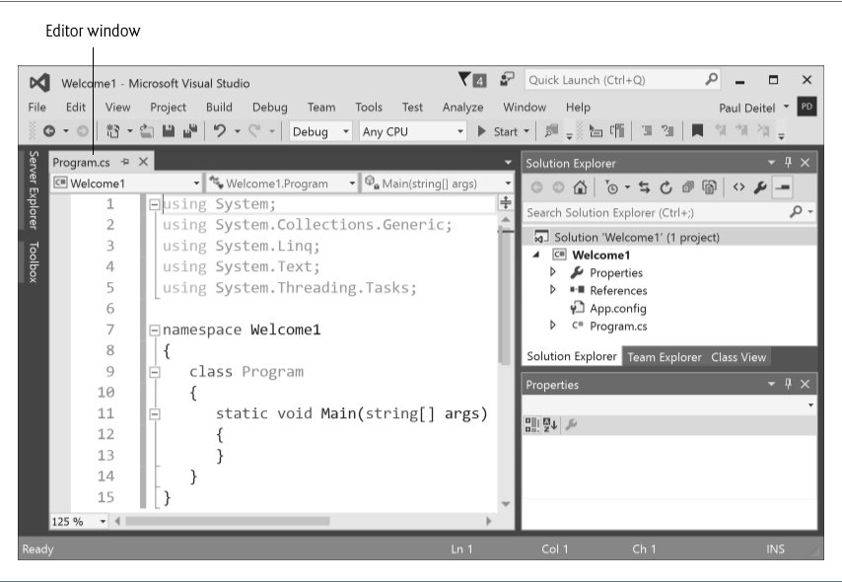
Figure 3.4 I D E with an Open Console App's Code Displayed in the Editor and the Project's Contents Shown in the Solution Explorer at the I D E's Top-Right Side

Slide 39
3.3.2 Changing the Name of the App File
To rename the app file, right click Program.cs in the Solution Explorer window and select Rename window
Type Welcome1 then press Enter.

Slide 40
Error-Prevention Tip 3.4
When changing a file name in a Visual Studio project, always do so in Visual Studio. Changing file names outside the I D E can break the project and prevent it from executing.

Slide 41
3.3.3 Writing Code and Using IntelliSense (1 of 2)
IntelliSense lists a class’s members, which include method names.
As you type, IntelliSense lists various items that start with or contain the letters you’ve typed so far.
IntelliSense also displays a tool tip containing a description of the first matching item.

Slide 42
3.3.3 Writing Code and Using IntelliSense (2 of 2)
You can either type the complete member name, double click the member name in the member list or press the Tab key to complete the name.
While the IntelliSense window is displayed pressing the Ctrl key makes the window transparent so you can see the code behind the window.

Slide 43
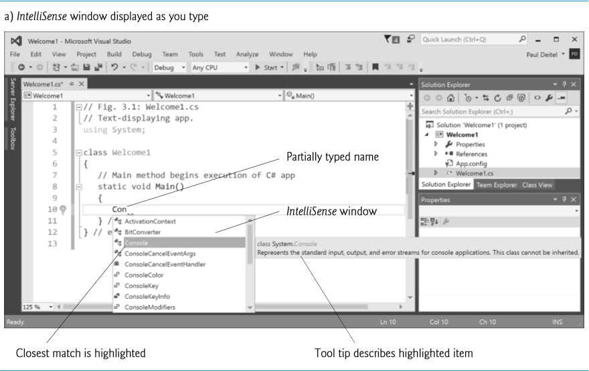
Figure 3.5 IntelliSense Window as You Type “Con”

Slide 44
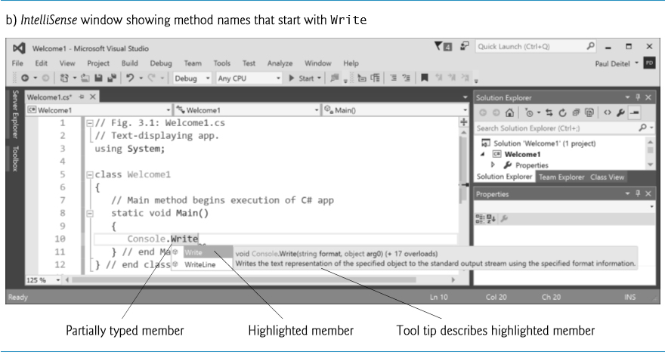
Figure 3.6 IntelliSense Window

Slide 45
3.3.3 Writing Code and Using IntelliSense
When you type the open parenthesis character, (, after a method name, the Parameter Info window is displayed (Figure 3.7).
This window contains information about the method’s parameters.
Up and down arrows allow you to scroll through overloaded versions of the method.

Slide 46
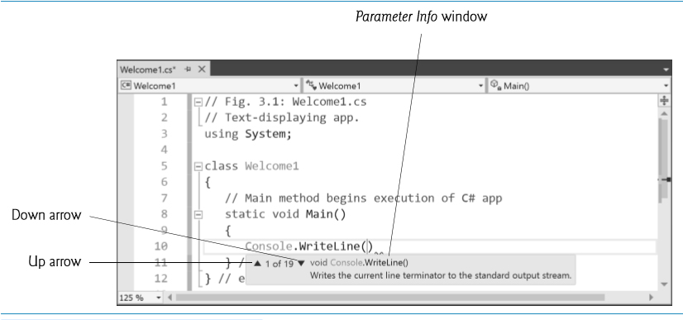
Figure 3.7 Parameter Info Window

Slide 47
3.3.4 Compiling and Running the App
To compile the app, select Build → Build Solution.
This invokes the Main method.
Figure 3.8 shows the results of executing this app, displayed in a console (Command Prompt) window.

Slide 48
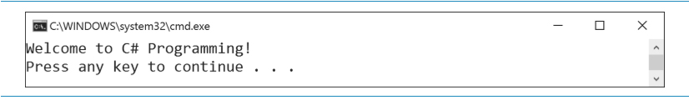
Figure 3.8 Executing the App Shown in Figure 3.1

Slide 49
3.3.5 Errors, Error Messages and the Error List Window
As you type code, the I D E responds either by applying syntax-color highlighting or by generating a syntax error.
A syntax error indicates a violation of Visual
rules for creating correct apps.
When a syntax error occurs, the I D E underlines the location of the error with a red squiggly line and provides a description of it in the Error List window (Figure 3.9).

Slide 50
Error-Prevention Tip 3.5
One compile-time error can lead to multiple entries in the Error List window. Each error you correct could eliminate several subsequent error messages when you recompile your app. So when you see an error you know how to fix, correct it—the I D E will recompile your code in the background, so fixing an error may make several other errors disappear.

Slide 51
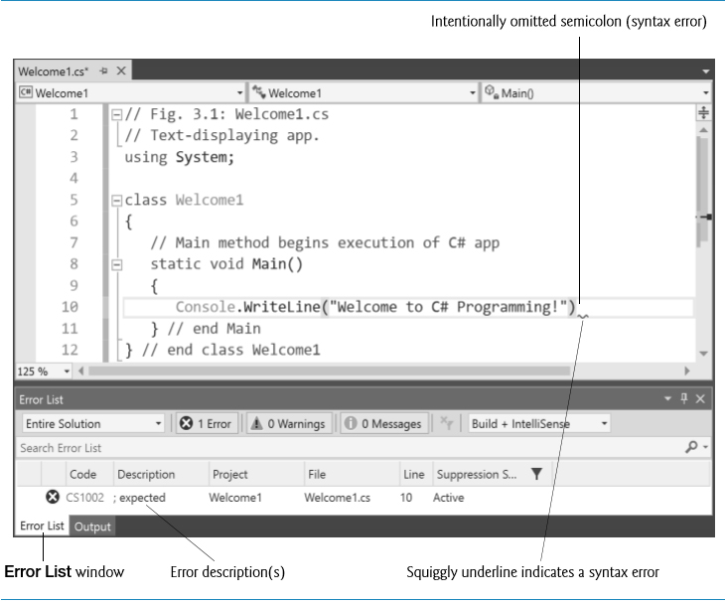
Figure 3.9 Syntax Error Indicated by the I D E

Slide 52
3.4.1 Displaying a Single Line of Text with Multiple Statements
Class Welcome2, shown in Figure 3.10, uses two statements to produce the same output as that shown in the previous example.
Unlike WriteLine, the Console class’s Write method does not position the screen cursor at the beginning of the next line in the console window.

Slide 53
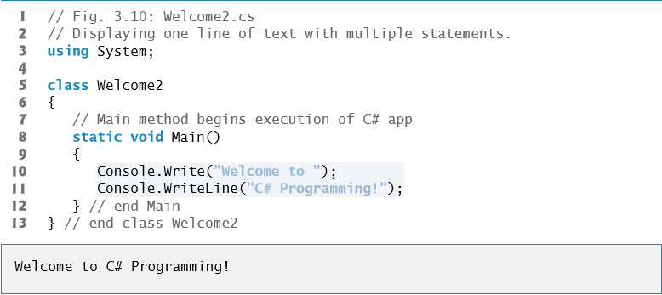
Figure 3.10 Displaying One Line of Text with Multiple Statements

Slide 54
3.4.2 Displaying Multiple Lines of Text with a Single Statement (1 of 2)
A single statement can display multiple lines by using newline characters.
Like space characters and tab characters, newline characters are whitespace characters.
The app of Figure 3.11 outputs four lines of text, using newline characters to indicate when to begin each new line.

Slide 55
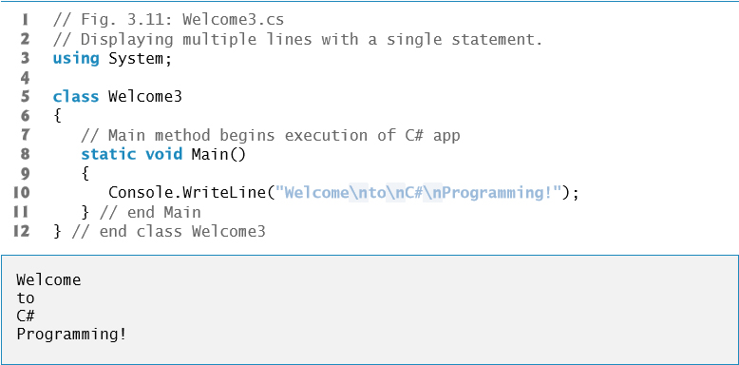
Figure 3.11 Displaying Multiple Lines with a Single Statement

Slide 56
3.4.2 Displaying Multiple Lines of Text with a Single Statement (2 of 2)
The backslash (\) is called an escape character, and is used as the first character in an escape­ sequence.
The escape sequence \n represents the newline character.
Figure 3.12 lists several common escape sequences and describes how they affect the display of characters in the console window.

Slide 57
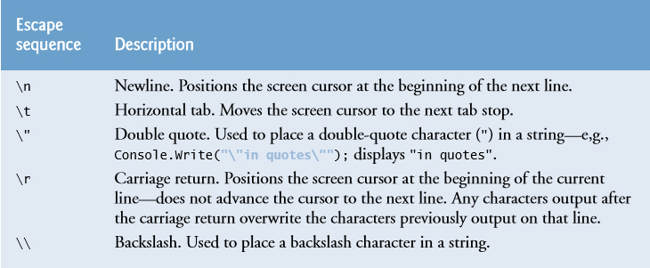
Figure 3.12 Common Escape Sequences

Slide 58
3.5 String Interpolation
Many programs format data into strings.
•
6 introduces a mechanism called string interpolation
that enables you to insert values in string literals to create formatted strings.
Figure 3.13 demonstrates this capability.

Slide 59
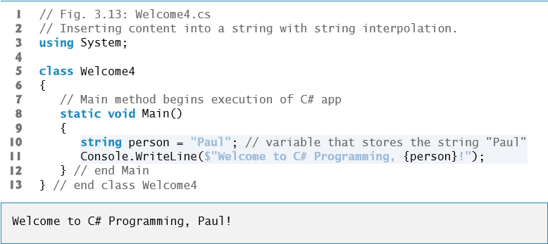
Figure 3.13 Inserting Content into a string with string Interpolation

Slide 60
3.5 String Interpolation (1 of 2)
A variable declaration statement (also called a declaration) specifies the name and type of a variable.
A variable is a location in the computer’s memory where a value can be stored for later use.
Variables are declared with a name and a type before they’re used:
A variable’s name enables the app to access the corresponding value in
A variable’s type specifies what kind of information is stored at that location in memory.
Variables of type string store character-based information.
Like other statements, declaration statements end with a semicolon (;).

Slide 61
3.5 String Interpolation (2 of 2)
string interpolation inserts values into a string.
An interpolated string must begin with a $ (dollar sign). Then, you can insert interpolation expressions enclosed in braces, {}, anywhere between the quotes ("").
When
encounters an interpolated string, it replaces
each braced interpolation expression with the corresponding value

Slide 62
3.6 Another C sharp App: Adding Integers
Applications remember numbers and other data in the computer’s memory and access that data through app elements called variables.
A variable is a location in the computer’s memory where a value can be stored for use later in an app.
A variable declaration statement (also called a declaration) specifies the name and type of a variable.
A variable’s name enables the app to access the value of the variable in memory—the name can be any valid identifier.
A variable’s type specifies what kind of information is stored at that location in memory.

Slide 63
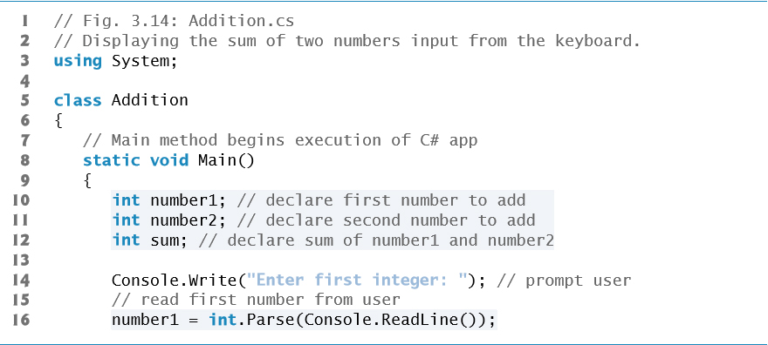
Figure 3.14 Displaying the Sum of Two Numbers Input from the Keyboard (1 of 2)

Slide 64
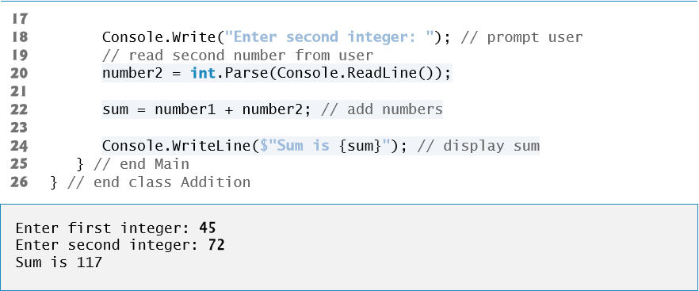
Figure 3.14 Displaying the Sum of Two Numbers Input from the Keyboard (2 of 2)

Slide 65
3.6.1 Declaring the int Variable number1
Variables of type int store integer values (whole numbers such as 7, –11, 0 and 31914).
Types float,double and decimal specify real numbers (numbers with decimal points).
Type char represents a single character.
These types are called simple types. Simple-type names are keywords and must appear in all lowercase letters.

Slide 66
Good Programming Practice 3.6
Declare each variable on a separate line. This format allows a comment to be easily inserted next to each declaration.

Slide 67
Good Programming Practice 3.7
Choosing meaningful variable names helps code to be self-documenting (i.e., one can understand the code simply by reading it rather than by reading documentation manuals or viewing an excessive number of comments).

Slide 68
Good Programming Practice 3.8
By convention, variable-name identifiers begin with a lowercase letter, and every word in the name after the first word begins with a capital letter (e.g., firstNumber). This naming convention is known as camel case.

Slide 69
3.6.3 Prompting the User for Input
A prompt because it directs the user to take a specific action

Slide 70
3.6.4 Reading a Value into Variable number1 (1 of 2)
Console’s ReadLine method waits for the user to type a string of characters at the keyboard and press the Enter key.
ReadLine returns the text the user entered.
The int.Parse method converts this sequence of characters into data of type int.

Slide 71
3.6.4 Reading a Value into Variable number1 (2 of 2)
A value can be stored in a variable using the assignment operator, =.
Operator = is called a binary operator, because it works on two pieces of information, or operands.
An assignment statement assigns a value to a variable.
Everything to the right of the assignment operator, =, is always evaluated before the assignment is performed.

Slide 72
Good Programming Practice 3.9
Place spaces on either side of a binary operator to make the code more readable.

Slide 73
3.6.5 Summing number1 and number2
An expression is any portion of a statement that has a value associated with it.
The value of the expression number1 + number2 is the sum of the numbers.
The value of the expression Console.ReadLine() is the string of characters typed by the user.
Calculations can also be performed inside output statements.

Slide 74
3.7 Memory Concepts (1 of 4)
Variable names actually correspond to locations in the computer’s memory.
Every variable has a name, a type, a size and a value.
In Figure 3.15, the computer has placed the value 45 in the memory location corresponding to number1.

Slide 75

Figure 3.15 Memory Location Showing the Name and Value of Variable number1

Slide 76
3.7 Memory Concepts (2 of 4)
In Figure 3.16, 72 has been placed in location number2.

Slide 77

Figure 3.16 Memory Locations After Storing Values for number1 and number2

Slide 78
3.7 Memory Concepts (3 of 4)
After sum has been calculated, memory appears as shown in Figure 3.17.

Slide 79

Figure 3.17 Memory Locations After Calculating and Storing the Sum of number1 and number2

Slide 80
3.7 Memory Concepts (4 of 4)
Whenever a value is placed in a memory location, the value replaces the previous value in that location, and the previous value is lost.
When a value is read from a memory location, the process is nondestructive.

Slide 81
3.8 Arithmetic (1 of 4)
The arithmetic operators are summarized in Figure 3.18.
The arithmetic operators in Figure 3.18 are binary operators.

Slide 82
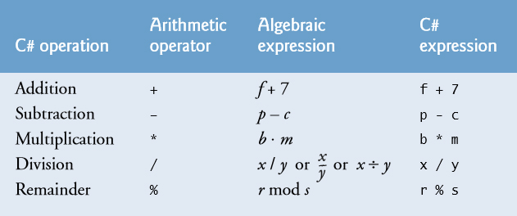
Figure 3.18 Arithmetic Operators

Slide 83
3.8 Arithmetic (2 of 4)
Integer division yields an integer quotient—any fractional part in integer division is simply truncated (discarded)—no rounding occurs.
provides the remainder operator,%, which yields
the remainder after division.
The remainder operator is most commonly used with integer operands but can also be used with floats, doubles, and decimals.

Slide 84
3.8 Arithmetic (3 of 4)
Arithmetic expressions must be written in straight-line form to facilitate entering an app’s code into the computer.
Expressions such as “a divided by b” must be written as a / b in a straight line.
Parentheses are used to group terms in
expressions in the same manner as in algebraic expressions.
If an expression contains nested parentheses, the expression in the innermost set of parentheses is evaluated first.

Slide 85
3.8 Arithmetic (4 of 4)
Arithmetic operators are evaluated according to the rules of operator precedence, which are generally the same as those followed in algebra (Figure 3.19).
As in algebra, it is acceptable to place unnecessary (redundant) parentheses in an ex­pression to make the expression clearer.

Slide 86
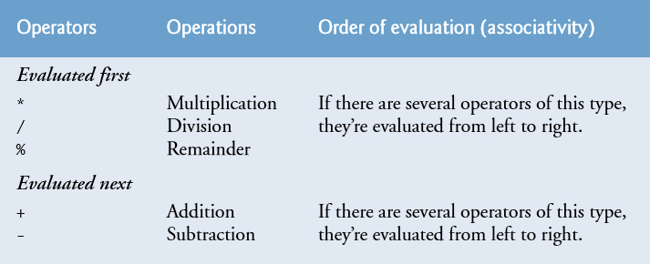
Figure 3.19 Precedence of Arithmetic Operators

Slide 87
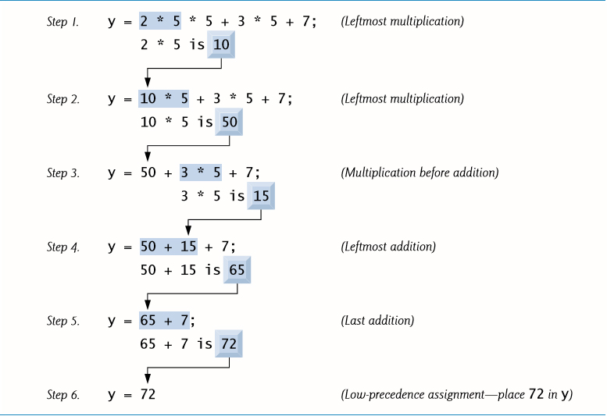
Figure 3.20 Order in Which a Second-Degree Polynomial is Evaluated

Slide 88
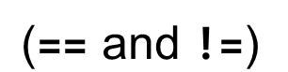
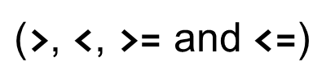
3.9 Decision Making: Equality and Relational Operators (1 of 4)
A condition is an expression that can be either true or false.
Conditions can be formed using the equality operators
and relational operators
summarized in Figure 3.21.

Slide 89
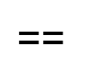
Common Programming Error 3.5
, with the assignment operator, =, can cause a logic error or a syntax error. The equality operator should be read as “is equal to,” and the assignment operator should be read as “gets” or “gets the value of.” To avoid confusion, some programmers read the equality operator as “double equals” or “equals equals.”
Confusing the equality operator,

Slide 90
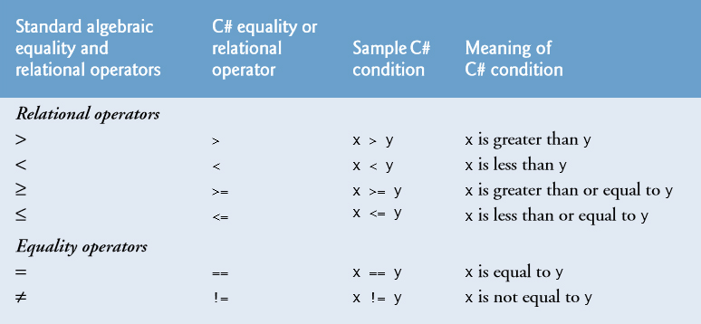
Figure 3.21 Relational and Equality Operators

Slide 91
3.9 Decision Making: Equality and Relational Operators (2 of 4)
Figure 3.22 uses six if statements to compare two integers entered by the user.

Slide 92
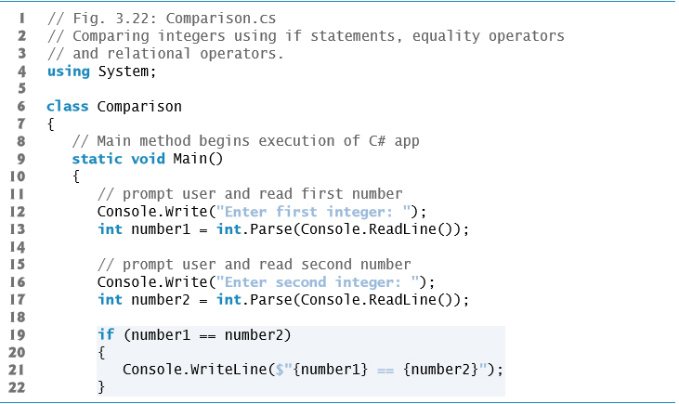
Figure 3.22 Comparing Integers Using If Statements, Equality Operators and Relational Operators (1 of 4)

Slide 93
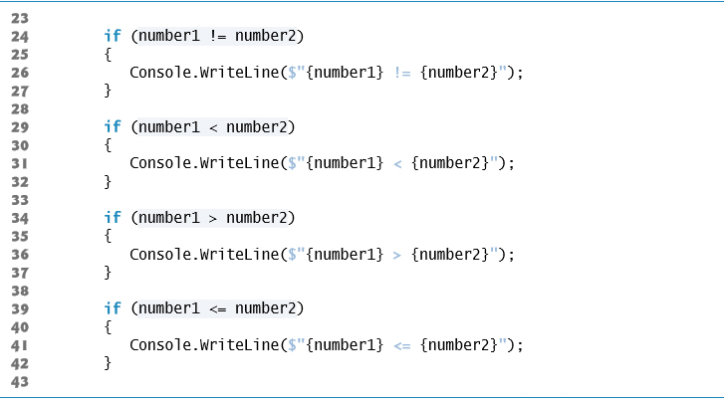
Figure 3.22 Comparing Integers Using If Statements, Equality Operators and Relational Operators (2 of 4)

Slide 94
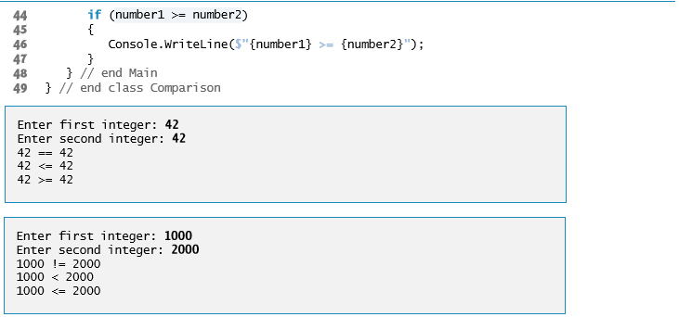
Figure 3.22 Comparing Integers Using If Statements, Equality Operators and Relational Operators (3 of 4)

Slide 95
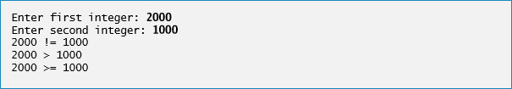
Figure 3.22 Comparing Integers Using If Statements, Equality Operators and Relational Operators (4 of 4)

Slide 96
3.9 Decision Making: Equality and Relational Operators (3 of 4)
If the condition in an if statement is true, the statement associated with that if statement executes.
An if statement always begins with keyword if, followed by a condition in parentheses.
An if statement expects one statement in its body.

Slide 97
Good Programming Practice 3.10
Indent the statement(s) in the body of an if statement to enhance readability.

Slide 98
Error-Prevention Tip 3.6
You don’t need to use braces, { }, around single-statement bodies, but you must include the braces around multiple-statement bodies. You’ll see later that forgetting to enclose multiple-statement bodies in braces leads to errors. To avoid errors and make your code more readable, always enclose an if statement’s body statement(s) in braces, even if it contains only a single statement.

Slide 99
Common Programming Error 3.6
Placing a semicolon immediately after the right parenthesis after the condition in an if statement is often a logic error (although not a syntax error). The semicolon causes the body of the if statement to be empty, so the if statement performs no action, regardless of whether or not its condition is true. Worse yet, the original body statement of the if statement now becomes a statement in sequence with the if statement and always executes, often causing the program to produce incorrect results.

Slide 100
Good Programming Practice 3.11
A lengthy statement can be spread over several lines. If a single statement must be split across lines, choose breaking points that make sense, such as after a comma in a commaseparated list, or after an operator in a lengthy expression. If a statement is split across two or more lines, indent all lines after the first until the end of the statement.

Slide 101
3.9 Decision Making: Equality and Relational Operators (4 of 4)
Figure 3.23 shows the precedence of the operators introduced in this chapter from top to bottom in decreasing order of precedence.

Slide 102
Good Programming Practice 3.12
Refer to the operator precedence chart (the complete chart is in Appendix A) when writing expressions containing many operators. Confirm that the operations in the expression are performed in the order you expect. If you’re uncertain about the order of evaluation in a complex expression, use parentheses to force the order, as you would do in algebraic expressions. Some programmers also use parentheses to clarify the order. Observe that some operators, such as assignment, =, associate from right to left rather than left to right.

Slide 103
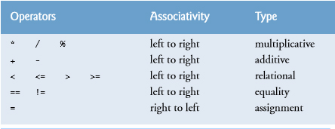
Figure 3.23 Precedence and Associativity of Operations Discussed So Far

Slide 104

Copyright

